Slide 1
Mantid Team structure

Slide 2
ISIS Development Team (currently)
Nick Draper (PM)
Martyn Gigg (Core)
Gemma Guest (ISIS LSS)
Sam Jackson (ISIS Diffraction)
Anders Markvardsen (ISIS Excitations & Muon)
Dan Nixon (Imaging)
Matthew Andrew
Elliot Oram
Anthony Lim
Keith Butler (Support)
Edward Brown
Joseph Ramsey
Matthew Bowles
Roman Tolchenov
Brandon Hewer
Tom Jubb

Slide 3
Next Releases
Mantid 3.13
Beta Testing 4th – 17th July
Expected release date 23rd July
Mantid 3.14
Dec-Jan
Mantid 3.15
Apr-May

Slide 4
Breakout sessions

Slide 5
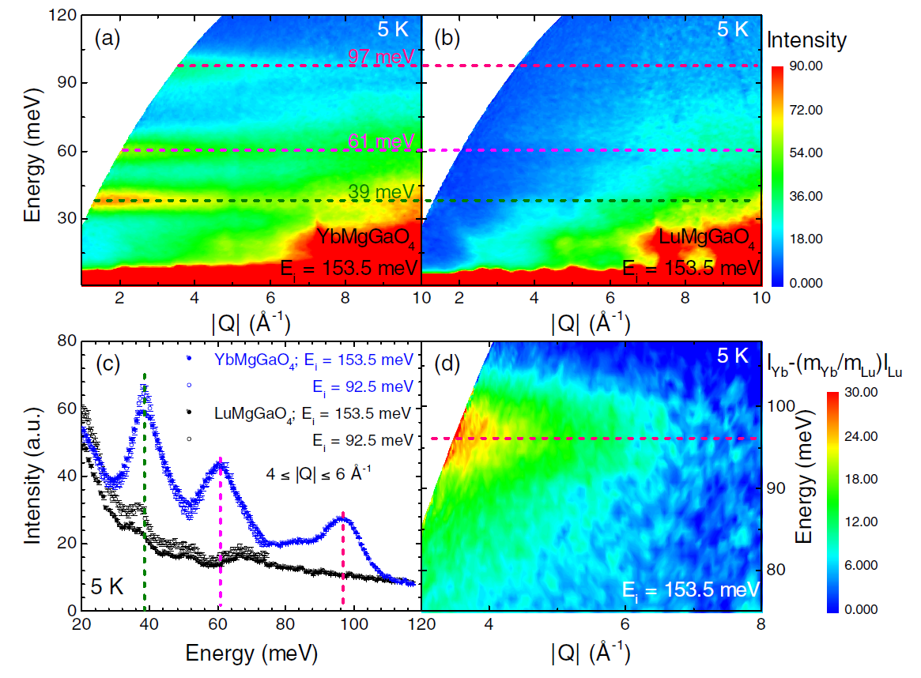
CEF global optimisers.
CEF levels can have anywhere from 3 to approx. 50 parameters to fit.
Currently, if params aren't almost perfect, steepest descent simply blows up peak widths.
We need an optimiser that can cope with this and discontinuous parameter space.

Slide 6
CEF global optimisers.
Mantid team will provide a script that different optimisers can be “plugged into”.
Adroja will test these optimisers on various different datasets, from trivial through to impossible and report back.
Best 2 or 3 will be folded into Mantid (and by extension CEF) proper by the mantid team.

Slide 7
Multiple scattering + absorption break-out session
Absorption
Generally good and tested support for this in Mantid
Some specialised implementation of the general Monte Carlo approach needs to be added, to offer higher speed in such cases
Scientists not aware of all absorption support in Mantid and there seems to be plenty of room for making better use of it
Multi
Support for specific cases in Mantid
The spec group, single crystal & SANS areas all have multi-element samples, which are known/believed to suffer significantly from multiple scattering but where currently such data are not corrected for this
Mantid supports an interface with McStas, which has general purpose support from multiple scattering. It was agreed it would be useful to test multiple scattering calculated from McStas simulations against real multi-element sample data to answer the question: would this produce believable corrections. Datasets suitable for tested this available from the spec group (water), from SANS (Iron-chromium) and single crystal (ErBaNiO5,CuSO4). This testing will not be easy. A initial estimate is that it would take ~3 months effort. Some of this effort may come from instruments scientists, but otherwise is was proposed it could be a student project with preferably a science/math background

Slide 8
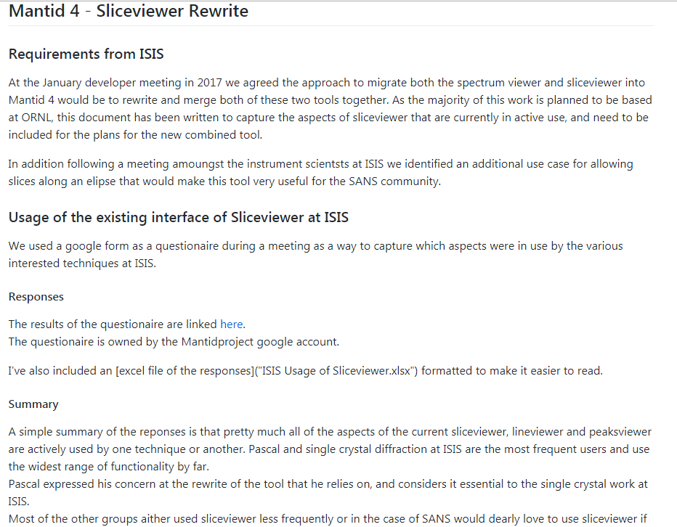
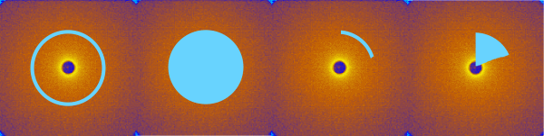
Sliceviewer & new Slicing features
Documented new slicing requirements
These need to be prioritised as normal
Gathered usage of ISIS sliceviewer usage
Both have been fed into M4 sliceviewer rewrite

Slide 9
Project Saving
Discussed the current Project saving & loading options
Can be slow for large data volumes
Can create larger files by not sharing metadata
Can be extended to interfaces (needs to be prioritised)
How about just saving the history?
This would benefit large data sizes, but rerunning them would take a lot of time as well.
Not portable
But a really good idea for recovery from crashes
Possible inclusion of early project recovery into the beta for r3.13

Slide 10
Straw man work plan
Requirements
Inputs to this meeting
User meeting discussions
Short/Medium term ISIS plan
Resourcing
Estimates
Availablility
Work Plans
Likely release date
Encourage discussion
Help elicit prioritisation

Slide 11
Core work plan
Release 3.13 (July)
Documentation improvements
See Also and algorithm categories
Error Reporting phase 2
Project recovery (beta)

Slide 12
Muon work plan (1)
Release 3.13 (July)
Explicit TF asymmetry fitting in the GUI
Better support for analysis with broken detectors
Release 3.14
Fourier-analysis interface, which includes support for MaxEnt analysis (Home, grouping, Transform only)
Save state of muon interface when saving a Mantid project

Slide 13
Muon work plan (2)
Later
Fourier-analysis interface, which includes support for MaxEnt analysis (data analysis and results table)
Richer (muon) function library in script repository
Revision of Time Differential Interface for new Mantid 4 (including unit tests)
Reader for NeXus-v2 muon files
Data loaders for other (muon) facilities;
Correction of PSI background;
Extension of Freq. domain interface for muonium chemistry
Negative muon analysis (algorithms and interface)
Revision of analysis interface to allow unit tests
Plot overlays (within interface)
Functions for modelling fitted data

Slide 14
SANS work plan (1)
Release 3.13 (Jun)
SANS: update the new sans GUI based on user feedback

Slide 15
SANS work plan (2)
Later
Defining ROI (lines, boxes, sectors, arcs, annuli) in instrument view and 2D plots - Extract plots vs counts vs pixel/q/azimuthal angle - integrated count/intensity
Mulitiplots of instrument view views and colour fill plots - With common colour scaling
"Finalising GUI V2. The SANS ISIS GUI V2 is now feature comeplete but has some issueswhich are blocking adoption. The aim is to get these ironed out for release 3.13."
"Investigate speed issues. The two main parts of this are looking into the speed issues with LoadISIS Nexus and investigating LARMOR in particular which was taking days to reduce data for one user."
"Apply dark current correction, this is already half done but needs to be investigated and implemented"
Test for multiple scattering
Resolve Beam Centre Finder issues with HAB
SESANS Reduction

Slide 16
Imaging work plan
Release 3.14
Iterative reconstruction using Tomopy in v1 GUI
Savu able to perform IMAT analysis workflow
Energy dispersive TOF neutron tomography using SAVU
SAVU webservice prototype
Later
Use of SAVU in GUI
Analysis of 4D TOF datasets, including reconstruction for sub ranges of wavelength
Imaging: Create requirement document for Bragg edge fitting

Slide 17
Powder Diff / Engineering work plan
Release 3.13 (July)
Powder: Expand ISIS Powder routines to Pearl
Release 3.14
Powder: Investigations about absorption correction
Later
Powder: Absorption corrections for non trivial shapes (pressure cells, hollow cans)
Engineering: log data info taken all the way to the results
Engineering: Fully integrate event mode support

Slide 18
Total Scatteringwork plan
Release 3.14
First pass of workflow for total scattering (possibly without GUDRUN merging).
Later
GUDRUN style merging
Addtional total scattering workflow items

Slide 19
SC Diffraction work plan
Release 3.13 (July)
Prediction and refinement of incommensurate peaks
Release 3.14 (Dec)
Tool for folding of peaks in q inside the 1st Brillouin Zone
Later
CrystalPlan intergration with Mantid geometry
Treatment of edge peaks
Extinction & Absorption Corrections
Integration of peaks in TOF in 3D
Multiple UBS

Slide 20
Direct Inelastic work plan
Release 3.13 (July)
Stability, particularly some form of error reporting for when Mantid falls over during script execution.
Finish Mslice.
Later
absorption: Improvements for hollow samples
absorption: allow cylinder orientation for MARI
Global fitting routines for CEF fitting

Slide 21
Reflectometry work plan
Release 3.13 (July)
Full Stack NR data reduction for 2D detectors part 1
Front End: ISIS NR GUI fixes and extensions part 1
Resolve problems with IDFs part 1
System tests for all reflectometers and cross facility
Release 3.14
Full Stack NR data reduction for 2D detectors part 2
Front End: ISIS NR GUI fixes and extensions part 2
Later:
Back End: High level (RROA) algorithm improvements
Full Stack NR data reduction for 2D detectors part 3
Resolve problems with IDFs part 2

Slide 22
Indirect Inelastic work plan (1)
Release 3.13 (July):
Allow for automated testing of 4 of the data analysis tabs within one GUI
QENS multiple dataset fitting GUI

Slide 23
Indirect Inelastic work plan (2)
Later:
Harmonisation of VESUVIO scripts/algorithms with those used for OSIRIS/IRIS diffraction
Calculations of errors in Fourier transform using Monte Carlo methods for QENS instruments and adding this to the reduction workflow
Re-enable FABADA to work with convolution fitting
Add support for EISF in the Indirect Data Analysis GUI
Add support for MDANSE and deprecate support for nMolDyn
Annotated scripts made available from one tab of the Data Reduction interface to read into for example a Jupyter notebook
GUI for VESUVIO
QuickRun GUI
Enable multi dataset for FABADA

